Slide 1



Financas
View in Power BI
Last data refresh:
28/03/2025 17:48:35 UTC
Downloaded at:
28/03/2025 17:53:21 UTC

Slide 2
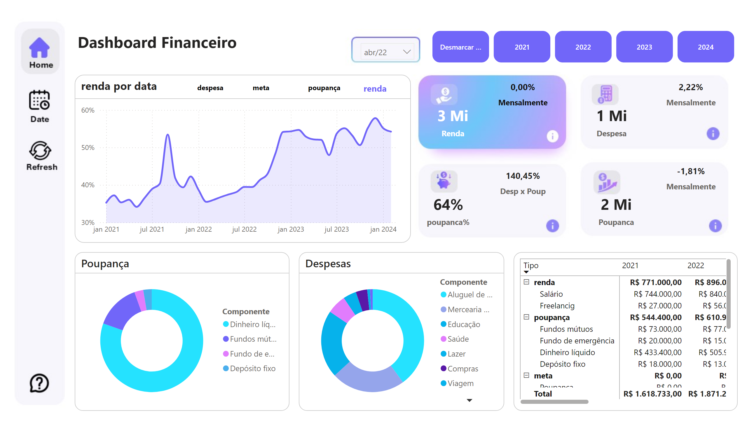
Página 1
Notes:
card
No alt text provided
card
No alt text provided
card
No alt text provided
card
No alt text provided
advancedSlicerVisual
No alt text provided
Poupança
No alt text provided
Despesas
No alt text provided
pivotTable
No alt text provided
renda por data
No alt text provided
advancedSlicerVisual
No alt text provided
textbox
No alt text provided
slicer
No alt text provided
card
No alt text provided
card
No alt text provided
card
No alt text provided
card
No alt text provided
slicer
No alt text provided
actionButton
No alt text provided
actionButton
No alt text provided
actionButton
No alt text provided

